Slide 1
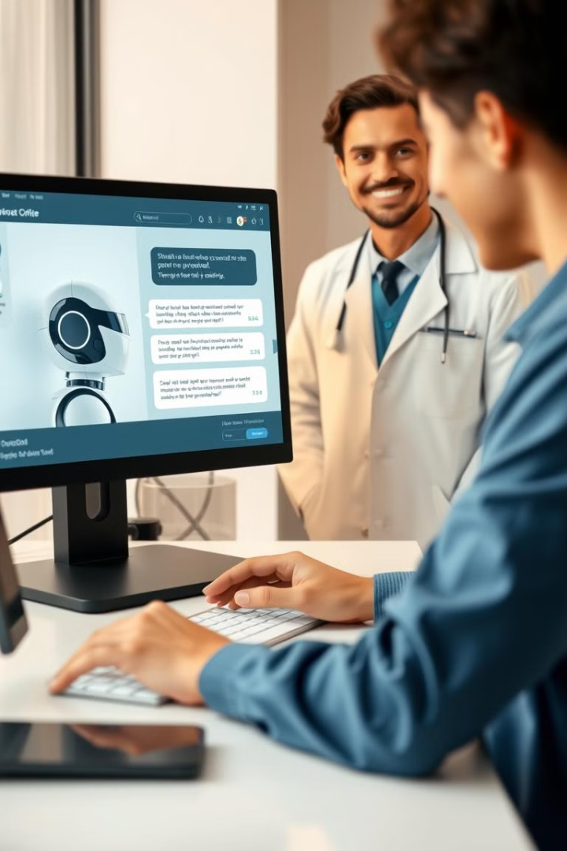
Automating Doctor Appointment Booking
This presentation outlines a revolutionary chatbot-based doctor appointment booking system designed to streamline the process of scheduling medical appointments, offering a user-friendly and efficient solution.

Slide 2
Problem Statement
Time-Consuming
Inefficient
Traditional appointment booking methods often involve lengthy phone calls, complex online forms, and inconvenient wait times.
Manual processes are prone to errors, missed appointments, and difficulty managing scheduling changes.
Manual Booking
24/7 Scheduling
Long wait times and limited availability.
Inability to book outside of office hours.
Long wait times
Limited accessibility
Manual booking often results in lengthy wait times for patients.
Scheduling is restricted to office hours, limiting access for those who work or are unavailable during those times.

Slide 3
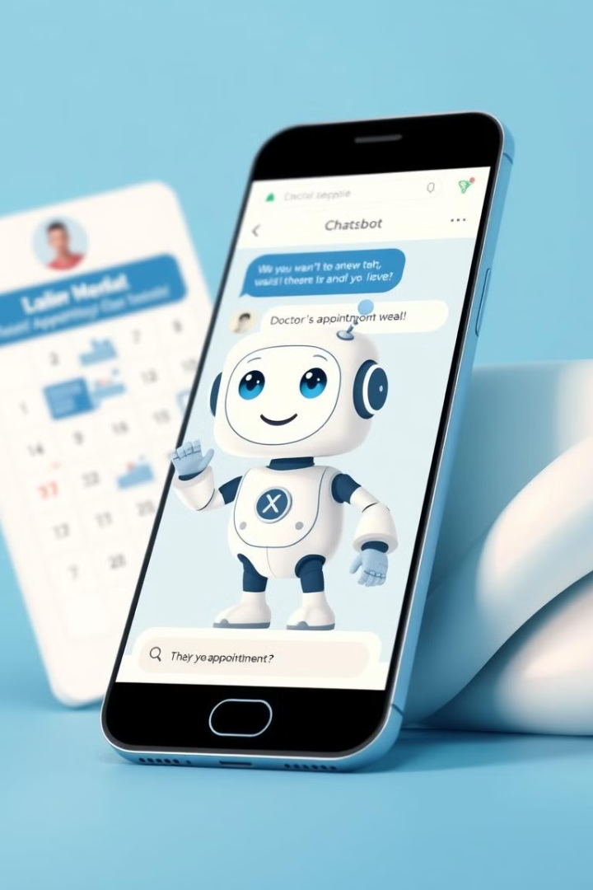
Introducing the Solution
1
Automated appointment booking, rescheduling, and cancellation.
2
Instant access to medical information tailored to user needs.
3
Effortless communication through a user-friendly chatbot interface.

Slide 4
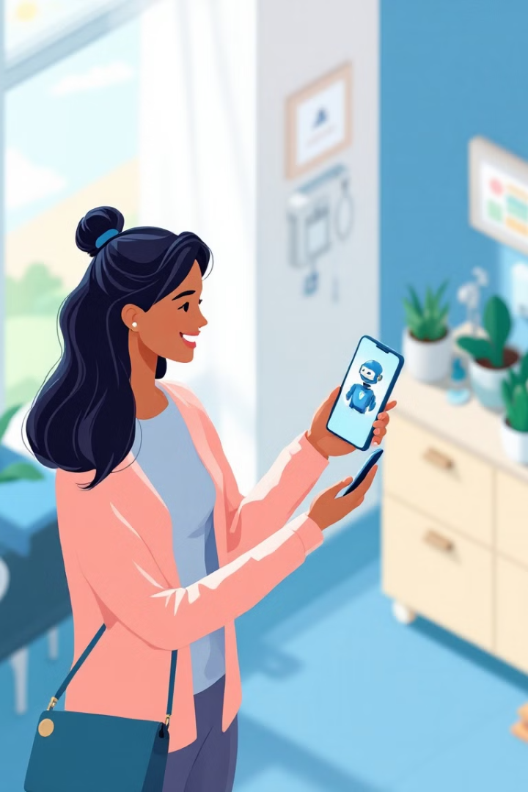
Addressing the Challenges
1
Automated booking
AI-powered conversation flow allows users to book appointments based on symptoms.
2
24/7 accessibility
Patients can book, reschedule, or cancel appointments at any time.
3
Symptom-based doctor selection
The system suggests appropriate doctors based on the user's symptoms.
4
Intuitive user interface
Chatbot-based interaction provides a user-friendly experience.

Slide 5
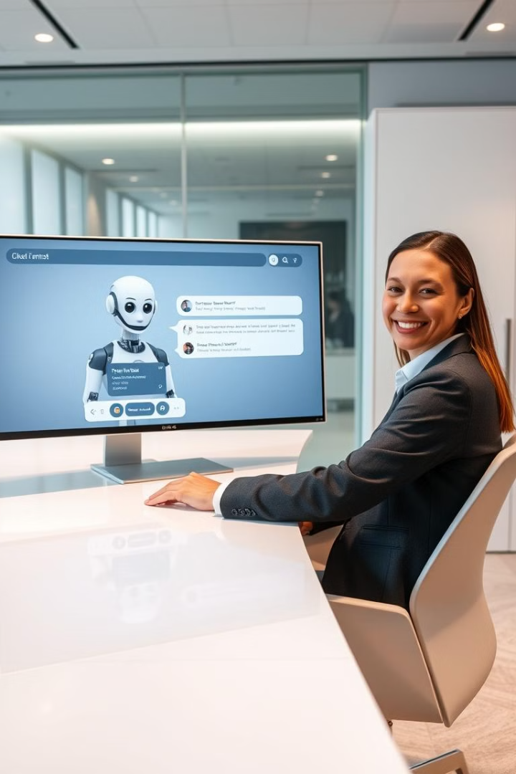
Key Features
Automated appointment booking
Rescheduling & cancellation
Patients can book appointments directly through the chatbot.
Users can easily modify or cancel appointments.
Email notifications
Receive confirmations, reschedulings, and cancellations via email.
Medical info retrieval
User-friendly interface
The chatbot provides basic information about common diseases.
A chatbot-based UI provides an
interactive experience.

Slide 6





Technology Stack
Python
Streamlit
Pandas
SMTP
Backend logic, chatbot functionality.
Frontend for chatbot-based interaction.
Data handling for doctor specialties and symptom mapping.
Email notifications for confirmation, rescheduling, and cancellations.
KaggleHub
Dataset integration for doctor specialization.

Slide 7
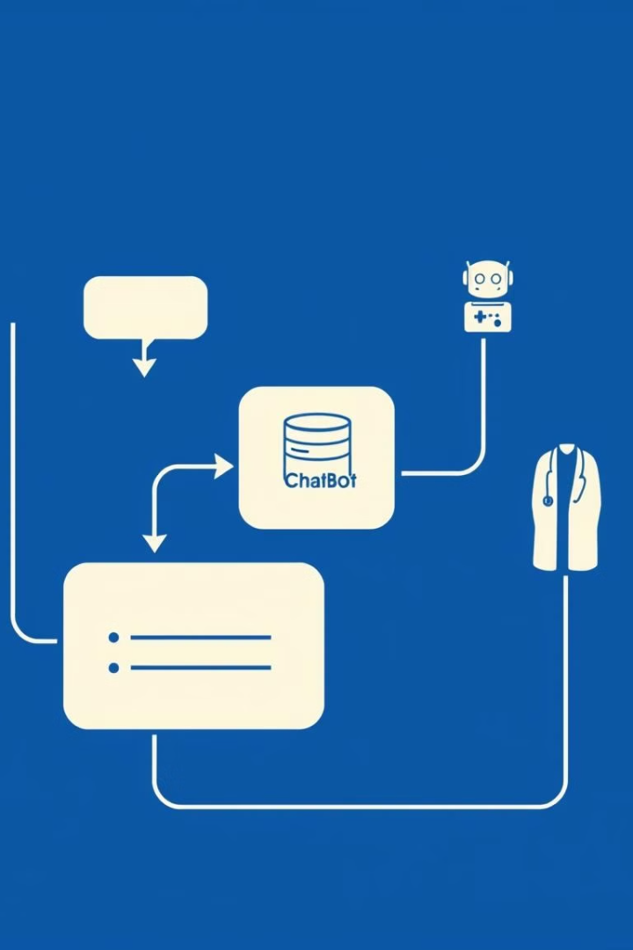




System Architecture
Users interact with the chatbot through a natural language interface.
The chatbot processes requests, validates user input, and manages appointments.
The system integrates with a database to store and retrieve appointment information.
The system uses email notifications to keep users informed about appointment details.

Slide 8
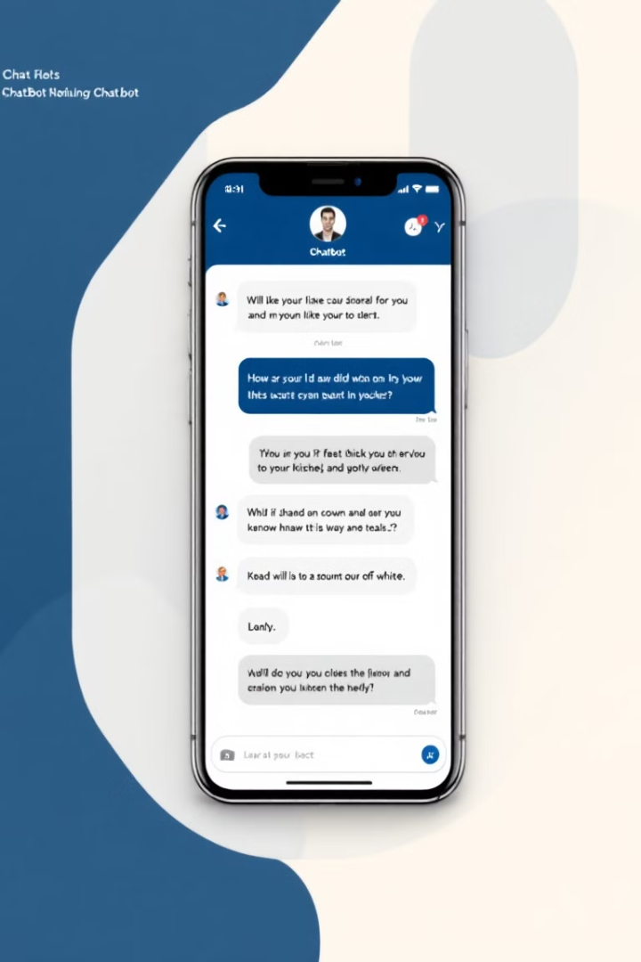
User Interface Design
Chatbot-based UI
Structured conversation flow for a guided user experience.
Simple & clean design
Clear visual indicators for different actions (confirmation, errors, notifications).

Slide 9
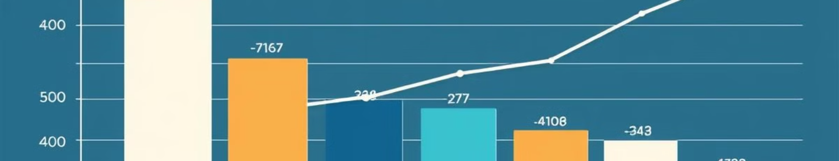
Data Handling
The system leverages a dataset containing information about doctors and their specializations.
User symptoms are mapped to relevant specialties for efficient doctor matching.
The chatbot analyzes user input, identifies relevant specialties, and recommends appropriate doctors.

Slide 10
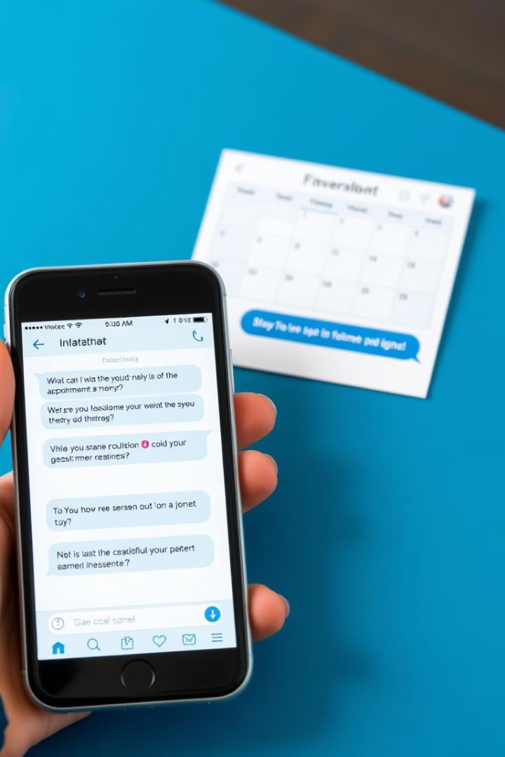
User Interaction Flow
Users initiate interaction by typing their request.
The chatbot processes the query, identifies the user's intent, and presents options.
Users choose from the options (Book, Reschedule, Cancel, Medical Info).
The chatbot validates input, executes the request, and provides confirmation.

Slide 11
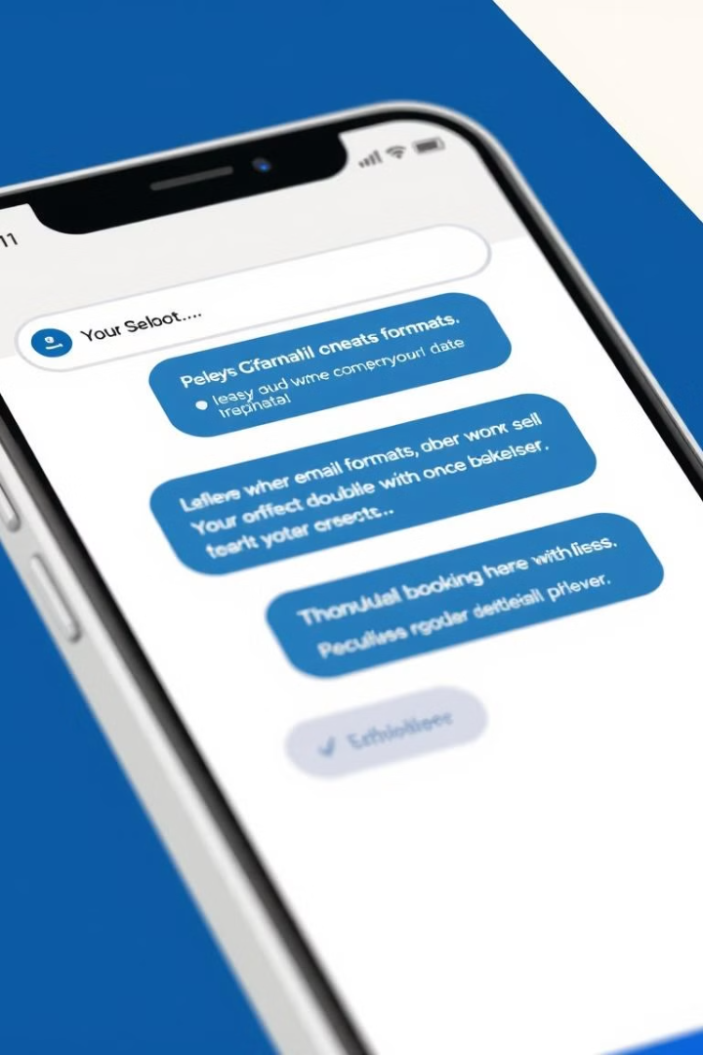
Error Handling and Validation
Prevents invalid inputs such as incorrect email formats, wrong dates, or double-booking attempts.
Ensures past dates and times cannot be selected to avoid incorrect scheduling.
Auto-corrects minor spelling mistakes in symptoms to improve doctor suggestions.
Time slot availability check to prevent double-booking of doctors.

Slide 12
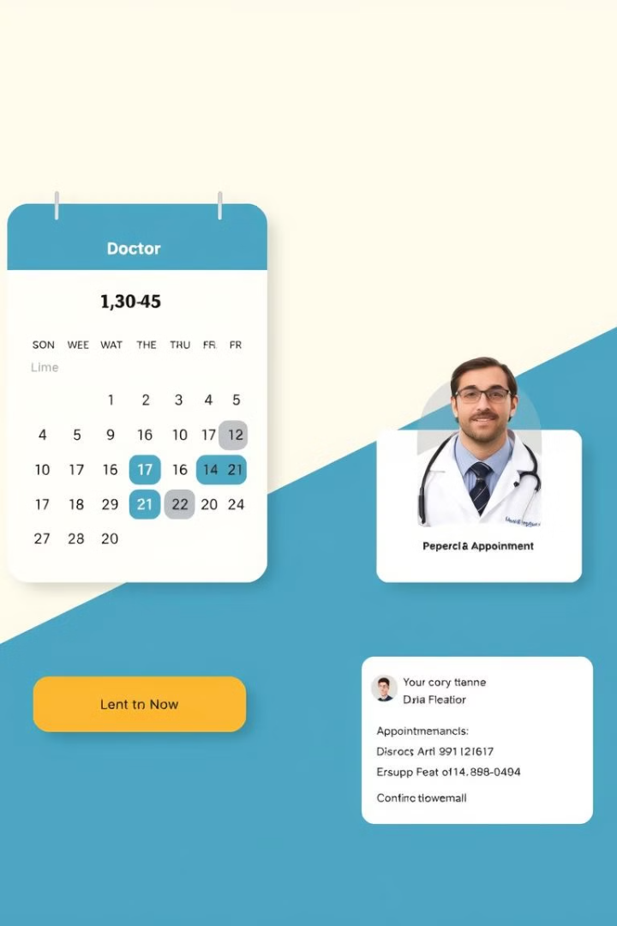



Appointment Booking Process
Users provide basic details like name, email, phone, symptoms, and preferred doctor.
The chatbot suggests available doctors based on user symptoms and preferences.
Users select a date and time from the available slots, based on doctor availability.
The system automatically sends an email confirmation with appointment details.

Slide 13
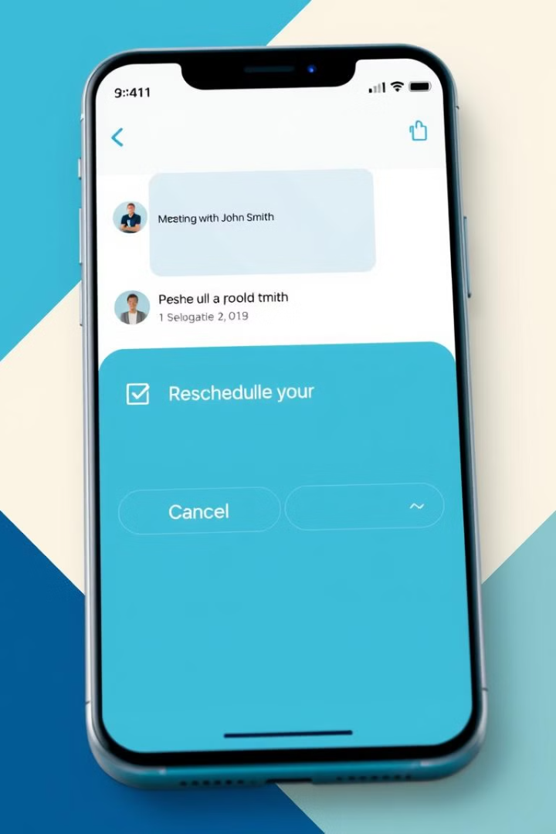
Rescheduling and Cancellation
Rescheduling
Users can reschedule by selecting a new date and time slot based on doctor availability.
Cancellation
Users can cancel their appointments, removing them from the system and freeing up the slot.

Slide 14
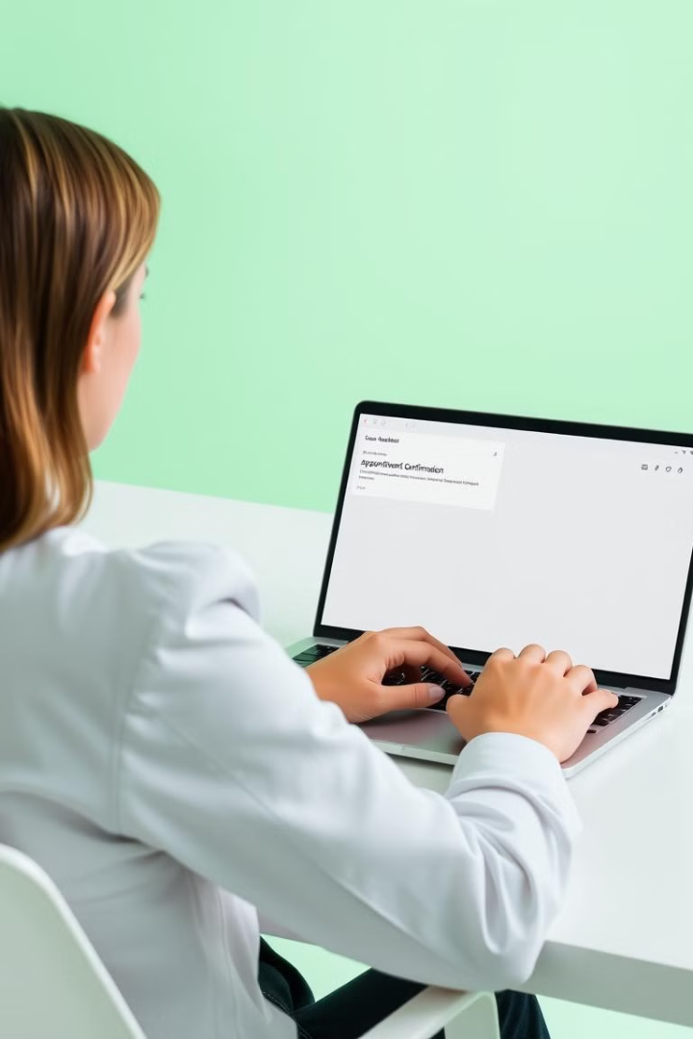
Email Notifications & Medical Info
Appointment Confirmation
Sent with booking details.
Reschedule Confirmation
Sent upon appointment modification.
Cancellation Confirmation
Notifies user of successful cancellation.
Medical Info Query
Users can ask about the number of individuals affected by a particular disease

Slide 15



Challenges and Solutions
Managing real-time appointment scheduling without conflicts.
Handling multiple user interactions simultaneously.
Ensuring accurate symptom-to-doctor mapping.
Implementing secure and efficient email notifications.

Slide 16



Next Steps and Future Enhancements
Multilingual Support
1
Expand the system to support various languages for wider accessibility.
Hospital Integration
2
Integrate with existing hospital management systems for real-time appointment updates.
AI-Powered Symptom Analysis
3
Implement AI-powered symptom analysis for more accurate doctor recommendations.

Slide 17

Thank You!
Thank you for your time and interest in the Doctor Appointment Chatbot. We welcome any questions or feedback you may have.

